Slide 1

Fasting Energetics of Seal Pups
GROUP 14
1

Slide 2
Outline
Introduction
Energy Acquisition in Seal Pups
Fasting Periods in Seal Pups
Adaptations
Environmental Factors Affecting Fasting
Importance of Fasting Energetics
Conclusion
2

Slide 3
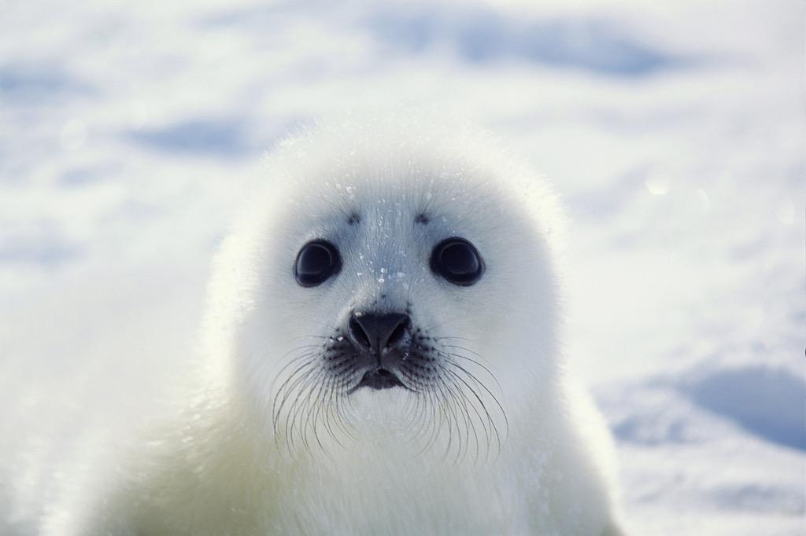
INTRODUCTION
This presentation explores the fascinating topic of fasting energetics in sea pups and its significance for their survival and development.
Seal pups, including seals and sea lions, are the young offspring of marine mammals.
They are found in polar, temperate and tropical regions or seas
Figure 1: A young seal pup
3

Slide 4
INTRODUCTION
Fasting energetics in seal pups refer to the physiological, structural and behavioural adaptation they undergo during period of not consuming food and water.
Fasting periods occur during the weaning process and may occur due to environmental factors like food scarcity or maternal foraging trips
The fasting last from two weeks to 9-12 weeks

Slide 5
Energy Acquisition in SeaL Pups
In the early stages of life, seal pups primarily rely on their mothers' milk as a source of energy and essential nutrients.
The high-fat content of the milk ensures that the pups receive the energy required for growth and thermoregulation in cold marine environments.
Figure 1:A young seal pup
5

Slide 6
Physiological Adaptations
Seal pups undergo ketosis to burn fat for energy instead of glucose.
Metabolic adjustments help them cope with limited energy availability.
They reduce water lose by concentrating urine and reabsorbing water from intestine during fasting.
8

Slide 7
STRUCTURAL ADAPTATION
Soft lanugo coat for retaining body heat during the fasting
Reduced growth rate
Thick layer of blubber reserves for insulation and source of stored fat for energy.
6

Slide 8
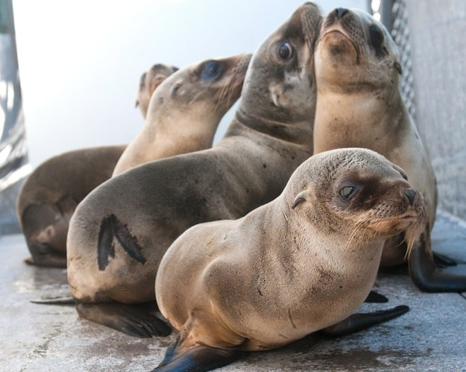
Behavioral adaptations
Seal pups reduce physical activity during fasting.
Seal pups may huddle together in groups during fasting to reduce heat loss.
Seal pups develop patience and endurance during fasting
Figure 1:Adult seal pups
7

Slide 9
Environmental Factors Affecting Fasting
Environmental factors, such as food availability and climate variations, significantly impact fasting energetics in sea pups.
Overfishing can disrupt the natural prey populations, affecting the timing and duration of fasting periods.
Predation
9

Slide 10
Importance of Fasting Energetics
The adaptation of sea pups to fasting helps them develop necessary skills for independence and self-sufficiency.
4

Slide 11
CONCLUSION
Understanding the fasting energetics of seal pups is essential for marine mammal conservation efforts.
Protecting their habitats, ensuring food availability, and minimizing human disturbances are vital for their survival.
10

Slide 12
REFERENCES
Ortiz, C. L., Costa, D., & Le Boeuf, B. J. (1978). Water and energy flux in elephant seal pups fasting under natural conditions. Physiological Zoology, 51(2), 166-178.
Sara J. Iverson, Heather N. Koopman, Encyclopedia of Marine Mammals (Third Edition), 2018
Michael Castellini, Encyclopedia of Marine Mammals (Second Edition), 2009

